Slide 1
Stock Analysis Package: A Comprehensive Tool for Financial Analysis
Shubham Narkhede,
Subham Moda,
Yanyun Wang,
Xinran Liu,
Zixin Zhou,
Course- FE 520
Under the Guidance of
Prof. Zin Chen

Slide 2
Introduction
The Stock Analysis Package is a Python-based tool designed for comprehensive financial analysis.
It utilizing the yfinance library (Reference: yf.Ticker).
Developed with a focus on empowering users to make informed investment decisions.

Slide 3
Overview of the Stock Analysis Package
The package provides a suite of features to aid in financial analysis, including data fetching, candlestick visualization, moving averages, MACD analysis, Bollinger Bands, and RSI.
Key Features:
Data Fetching:
fetch_stock_data method, which validates the stock symbol, date range, and ensures equity nature (Reference: quoteType).
Candlestick Visualization:
visualize_candlestick method using Plotly for interactive candlestick charts.

Slide 4
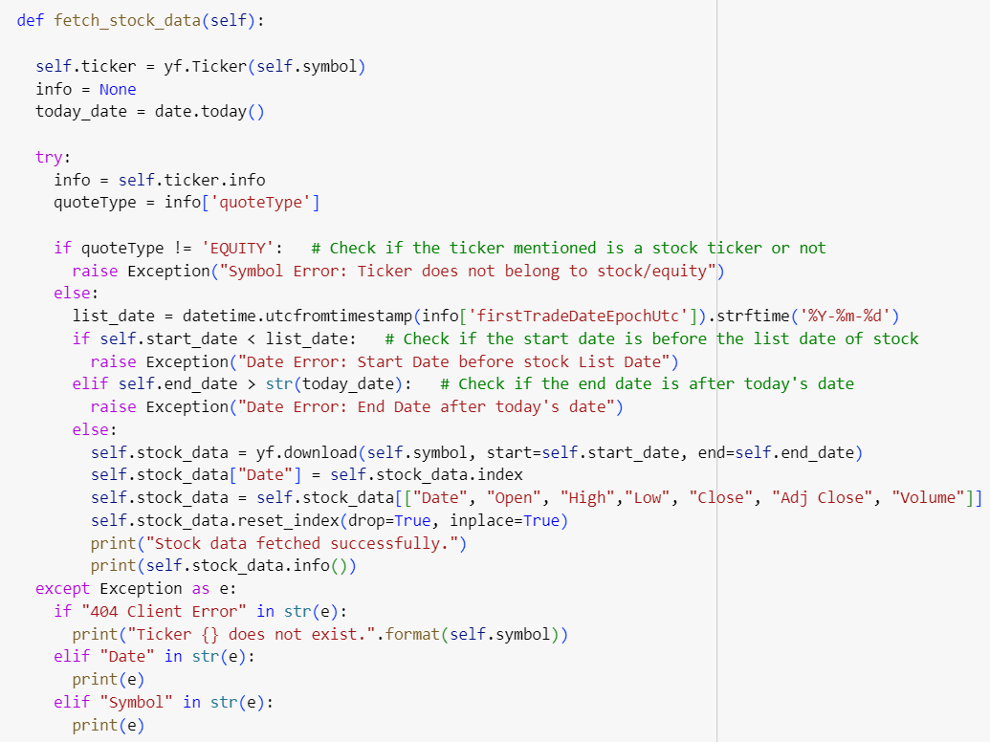
Data Fetching
The fetch_stock_data method ensures reliable data retrieval:
Validates the stock symbol and date range.
Verifies that the provided stock symbol belongs to an equity (Reference: quoteType).
Checks if the date range is within the stock's listing date and before the current date.

Slide 5
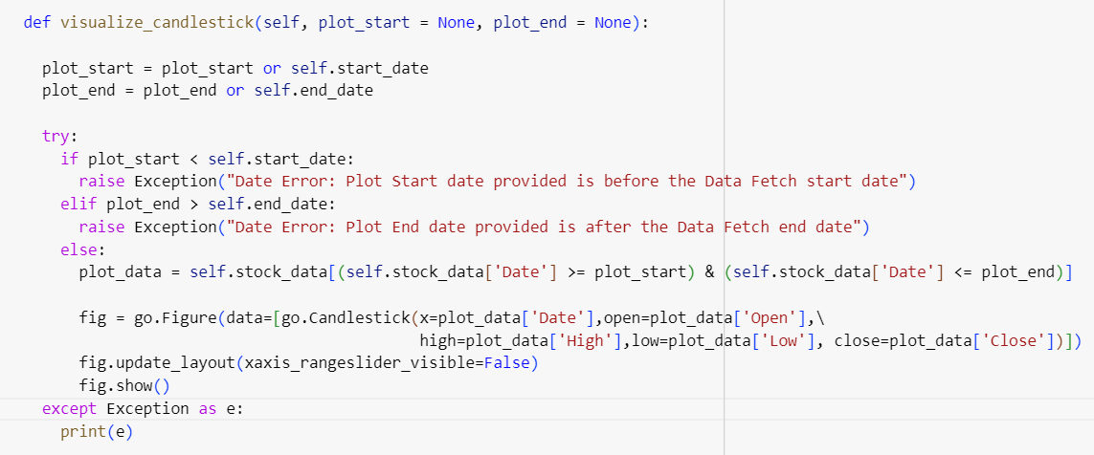
Candlestick Visualization
The visualize_candlestick method utilizes Plotly to create interactive candlestick charts.
Ensures focused analysis within a specified date range.

Slide 6
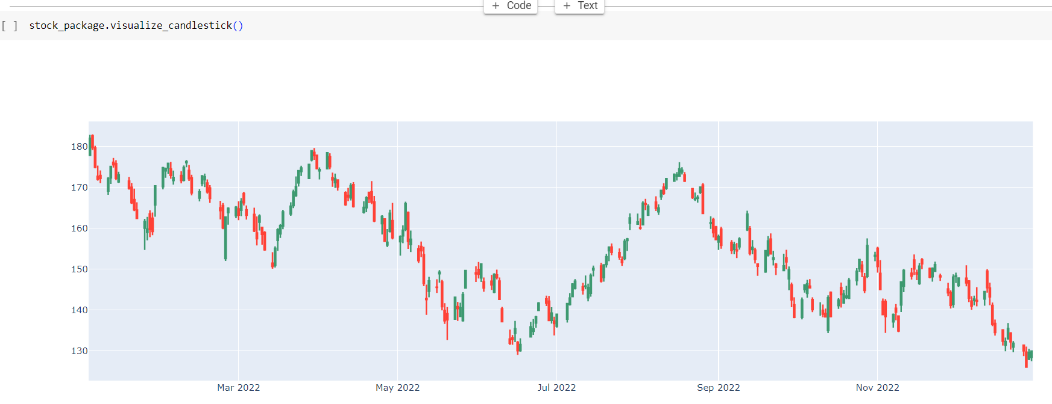
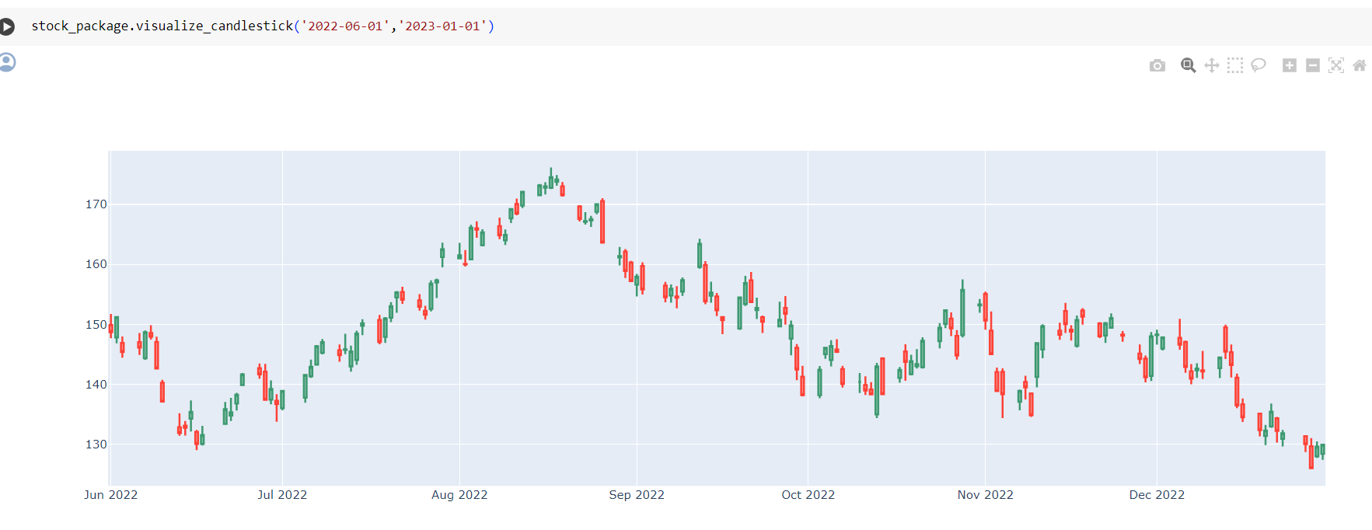
Candlestick Visualization

Slide 7
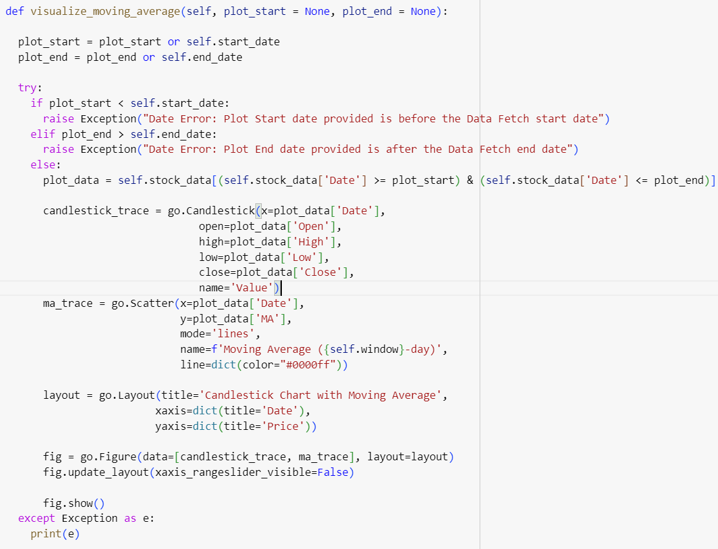
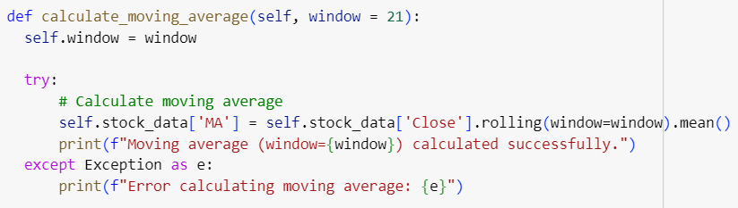
Moving Averages
The calculate_moving_average method computes a smoothed representation of price trends using a specified window.
The visualize_moving_average method combines candlestick charts with moving averages for comprehensive analysis.

Slide 8
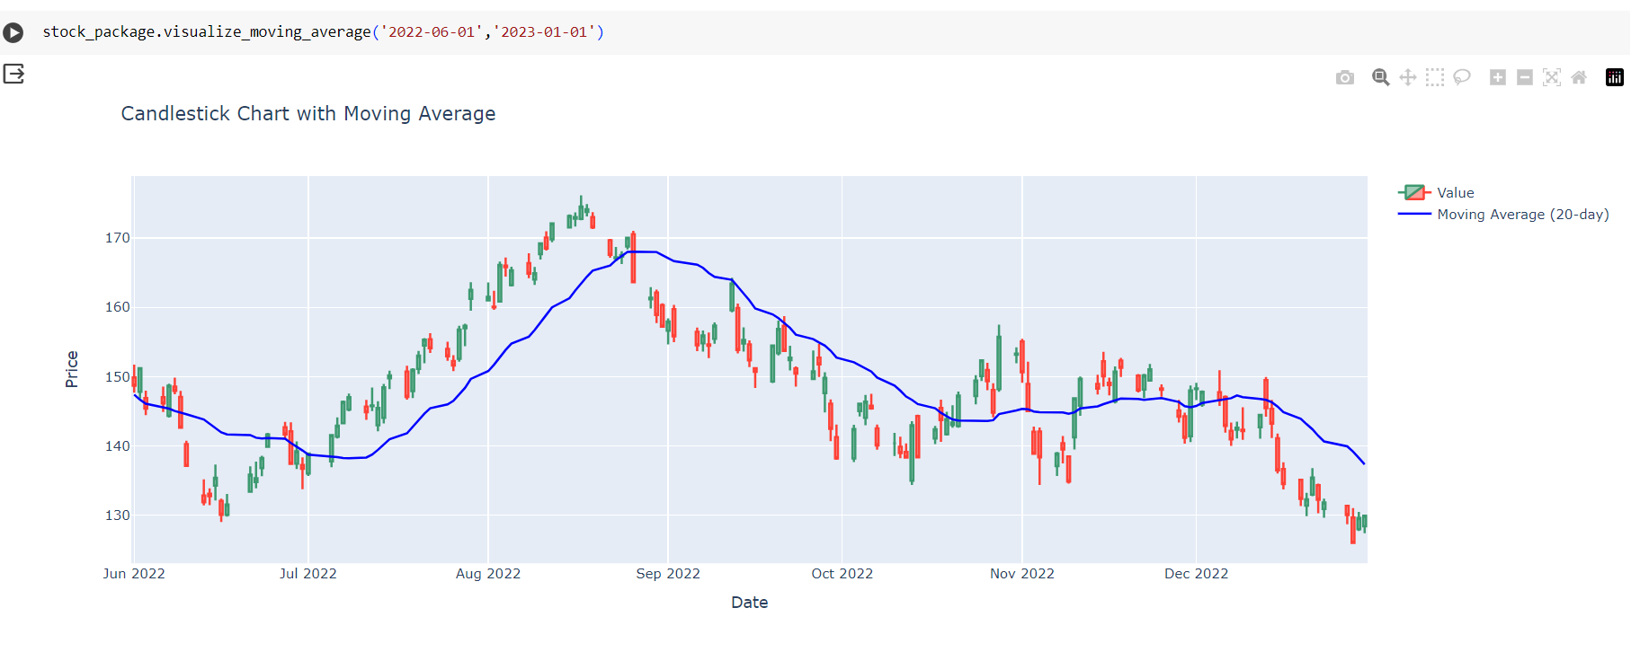
Moving Averages

Slide 9
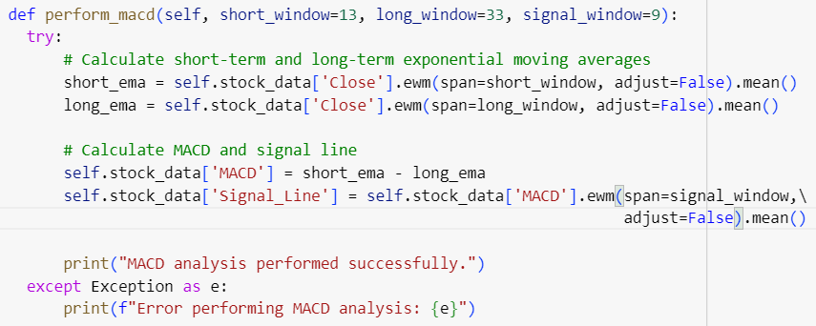
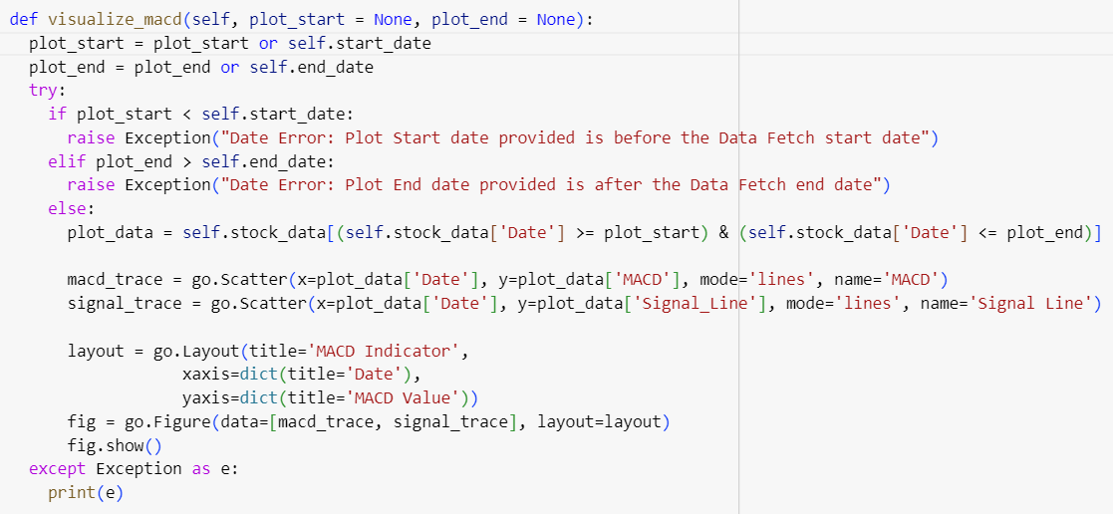
MACD Analysis
The perform_macd method calculates short-term and long-term exponential moving averages (EMAs).
The visualize_macd and visualize_macd_histogram methods provide visual representations of MACD and its histogram.

Slide 10
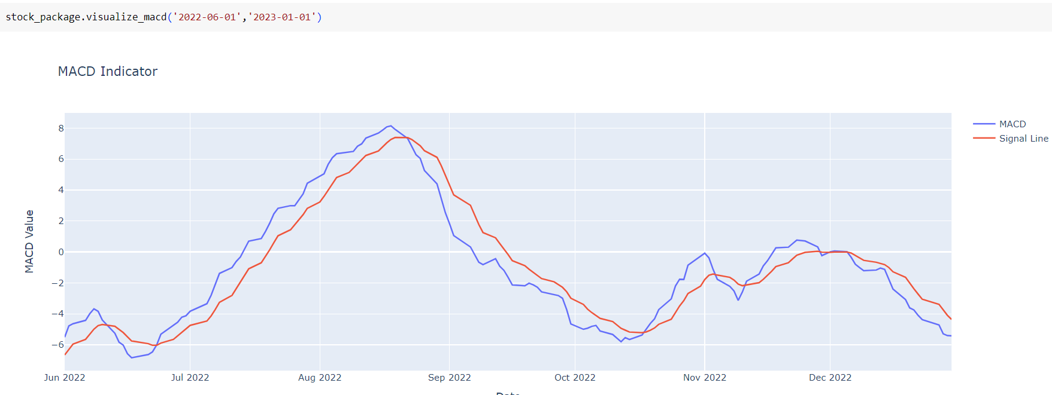
MACD Analysis

Slide 11
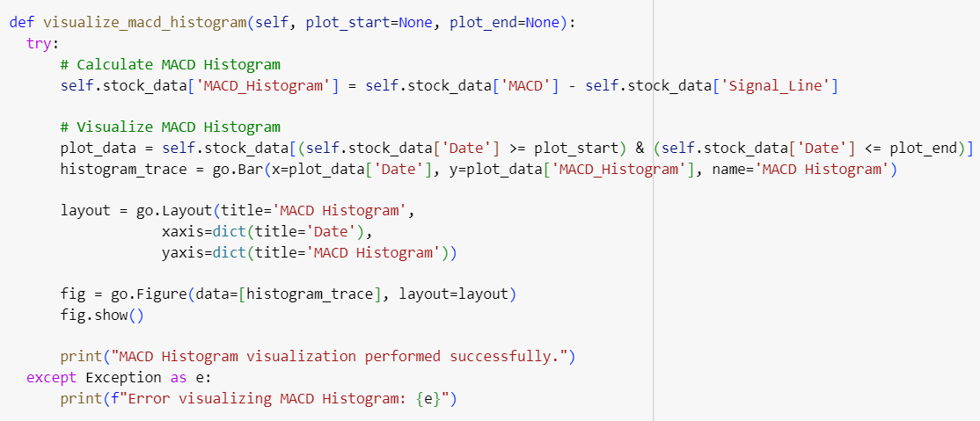
MACD Analysis Histogram
The perform_macd_histogram method calculates plots the histogram plot of the moving averages (EMAs) which helps in better visualization.

Slide 12
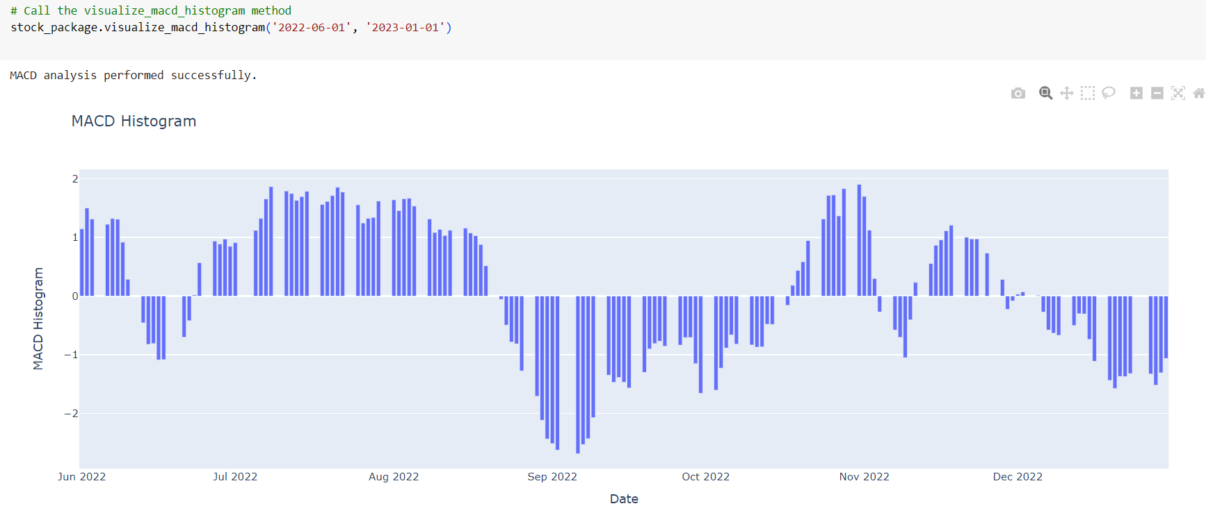
MACD Analysis Histogram

Slide 13
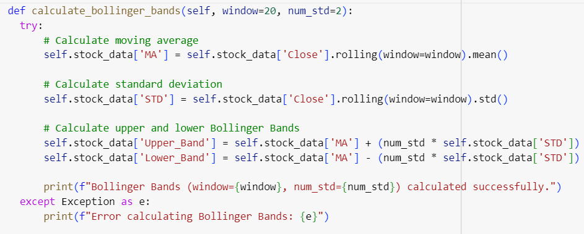
Bollinger Bands
The calculate_bollinger_bands method computes moving averages, standard deviations, and upper/lower Bollinger Bands for identifying potential reversals and volatility changes.
The visualize_bollinger_bands method combines Bollinger Bands with candlestick charts for comprehensive analysis.

Slide 14
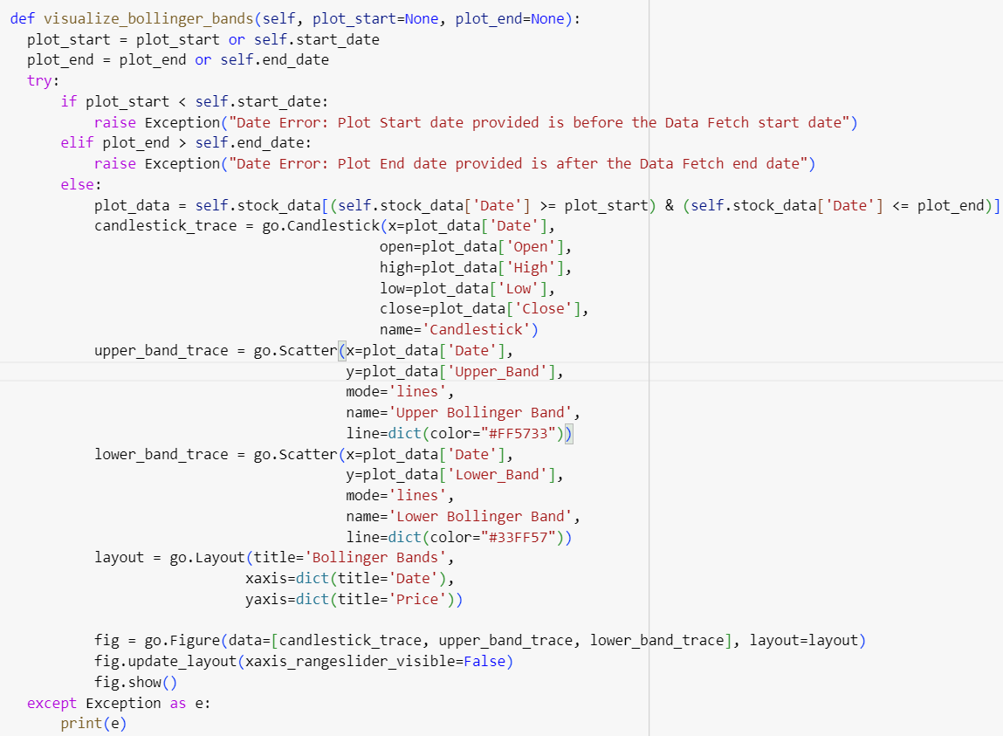
Bollinger Bands Visualization
The visualize_bollinger_bands function dynamically creates an interactive Plotly chart.
Integrating candlestick patterns with upper and lower Bollinger Bands for insightful market trend analysis.
Ensures user-defined date ranges are valid and appropriately handles errors for a seamless analytical experience.

Slide 15
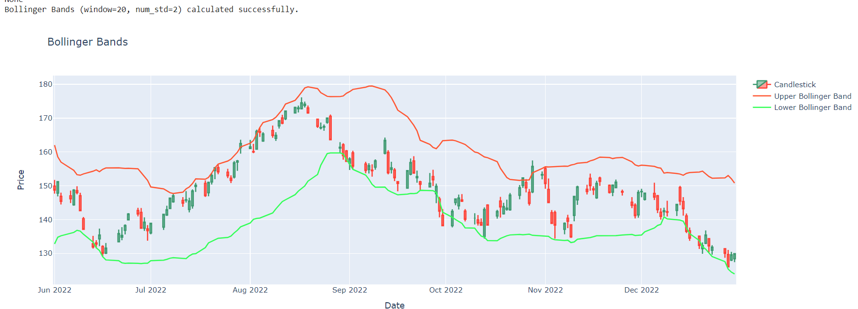
Bollinger Bands Visualization

Slide 16
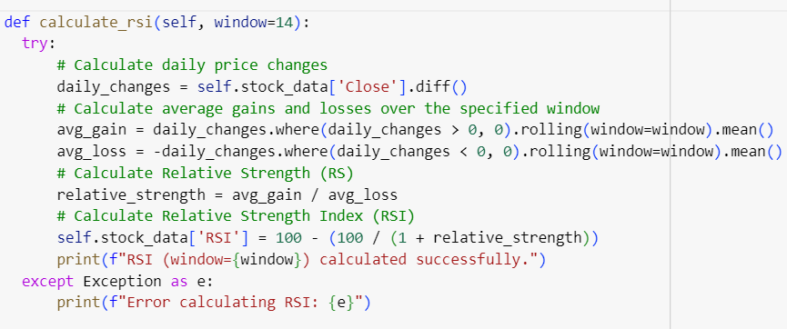
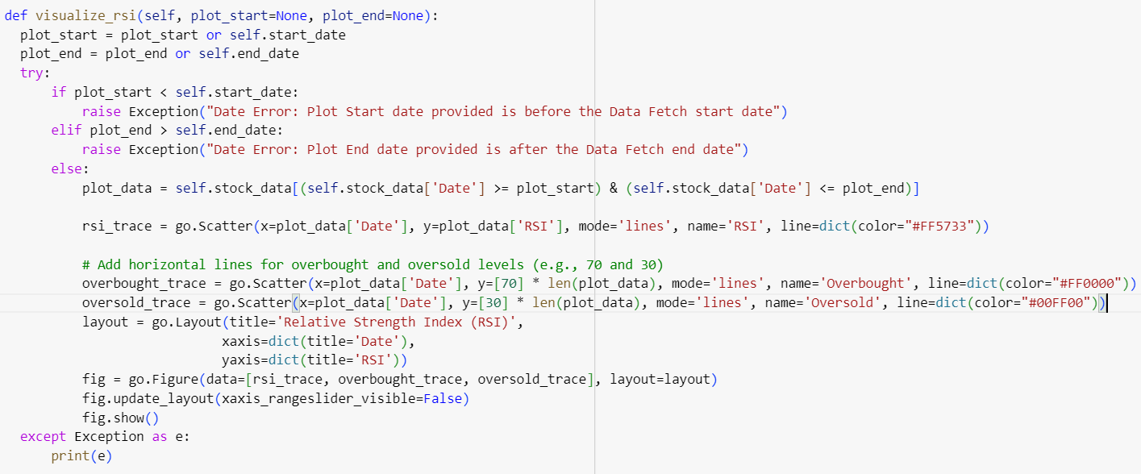
RSI (Relative Strength Index)
The calculate_rsi method computes the Relative Strength Index (RSI) to measure the speed and change of price movements.
The visualize_rsi method provides visual representations of RSI with overbought and oversold levels.

Slide 17
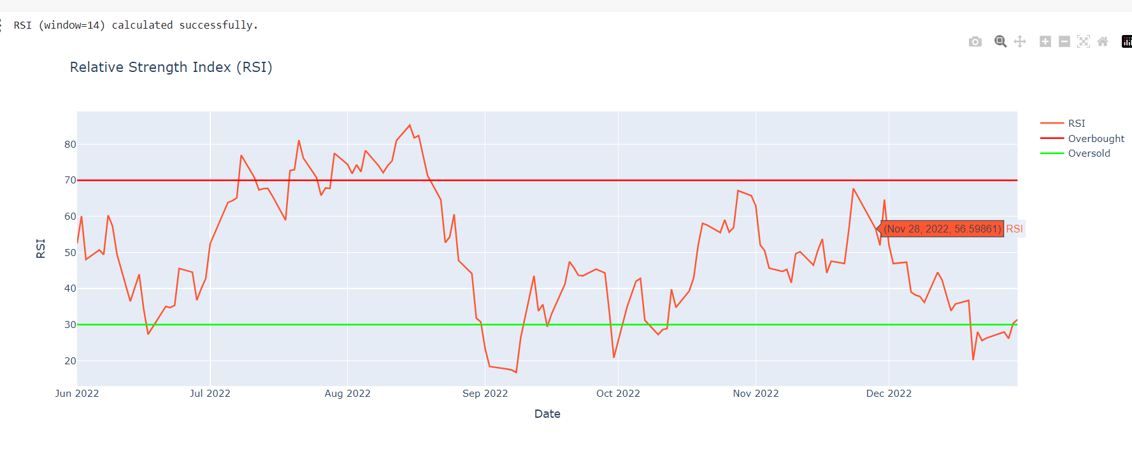
RSI (Relative Strength Index)

Slide 18
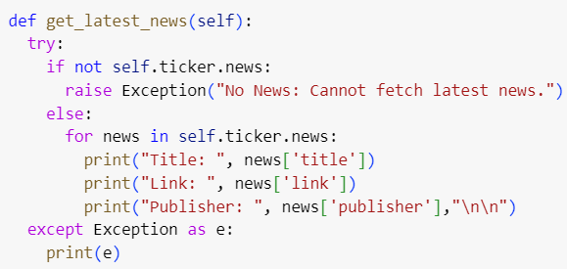
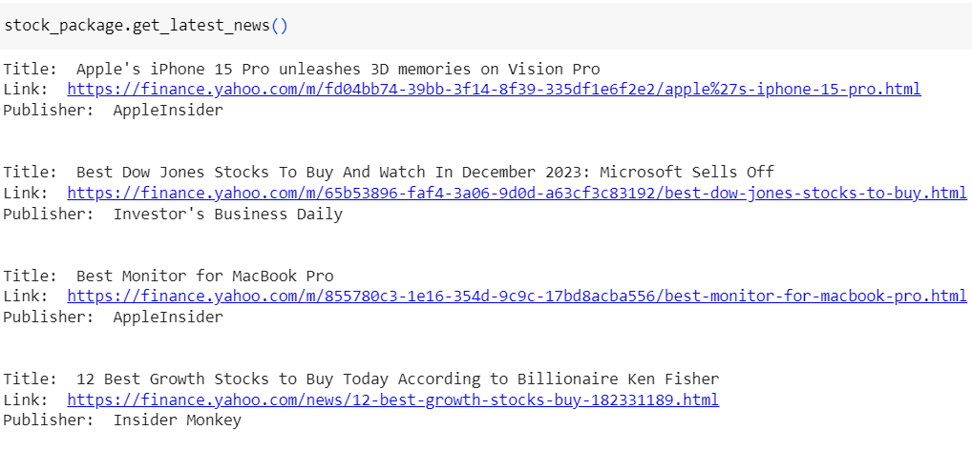
Latest News
The get_latest_news function leverages the Yahoo Finance API to fetch the latest news related to the stock.
Displays the title, link, and publisher for each news article, providing a comprehensive overview.
Robust error handling ensures a smooth user experience even when no news is available for the specified stock.

Slide 19
Benefits of Using the Stock Analysis Package
Comprehensive Analysis: The package offers a wide range of analytical tools.
User-Friendly Interface: Easy-to-use methods for fetching data and visualizing results.
Interactive Visualizations: Plotly-based charts enhance the user experience.
Error Handling: Robust error handling ensures reliable performance

Slide 20
Conclusion
Recap of the Stock Analysis Package's strengths.
Emphasis on its significance in financial analysis and decision-making.

Slide 21
THANK YOU
Stevens Institute of Technology
1 Castle Point Terrace, Hoboken, NJ 07030

